Slide 1
EECE 387 Design Lab
FINAL PROJECT
Anthony Ye, Colin Skelton,
Rakhesh Varshan Dhamodaran, Deborah Sridhar, Praneeth Vijayakumar

Slide 2
Table of
CONTENTS
Introduction: Design Problem
2. Hardware Implementation
3. Software Integration
4. Results
5. Conclusion
02

Slide 3
Introduction: Design Problem
Create a single self-contained metal detection system.
Design shall utilise electromagnetic coupling to detect and differentiate between three different metal objects.
How the designed system is demonstrated:
The metal detection system will be placed on a workbench and activated.
Three different metal objects will be used to test the system.
Each metal object will be placed in proximity of the magnetic coil five times using the sequence determined by the instructors.
The number of times that the metal objects are detected AND correctly identified will be recorded.
03

Slide 4
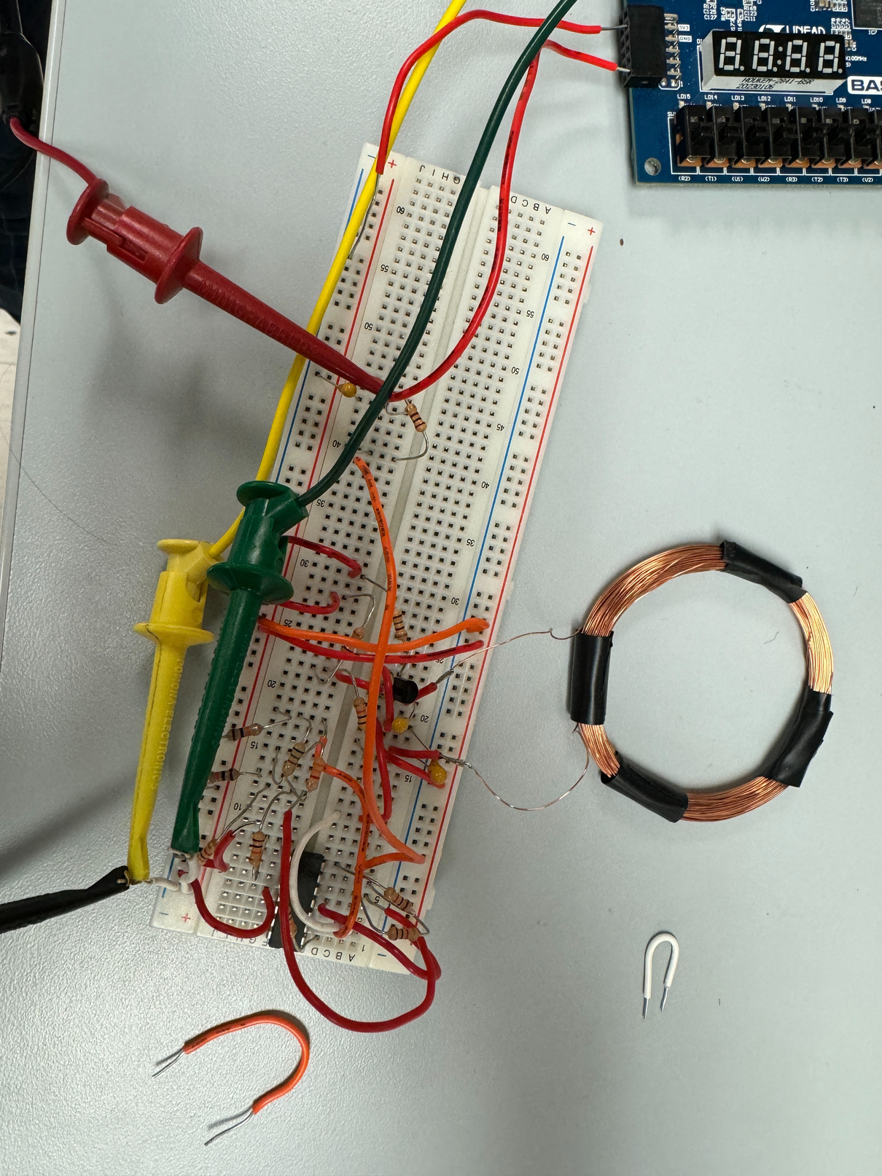
Hardware Implementation
The circuit consists of three components:
Colpitts Oscillator
LM324 Op Amp Comparator
RC Low-Pass Filter
The Colpitts Oscillator creates a high-frequency sinusoidal wave.
This wave is put into an op-amp comparator, resulting in a square wave with a quantitative duty cycle percentage.
Bringing a metal close to the coil causes the frequency of the oscillator to increase, thus decreasing the duty cycle of the square wave.
This square wave is then put into an RC low-pass filter, allowing voltage to vary with the duty cycle.
04
Fig. represents the circuit design

Slide 5
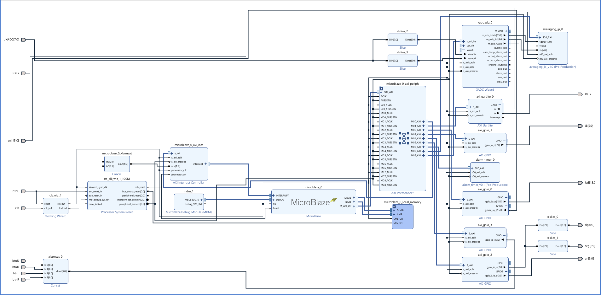
Software Integration
05

Slide 6
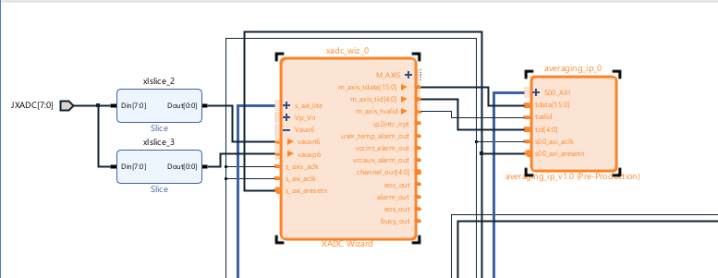
Software Integration
06

Slide 7
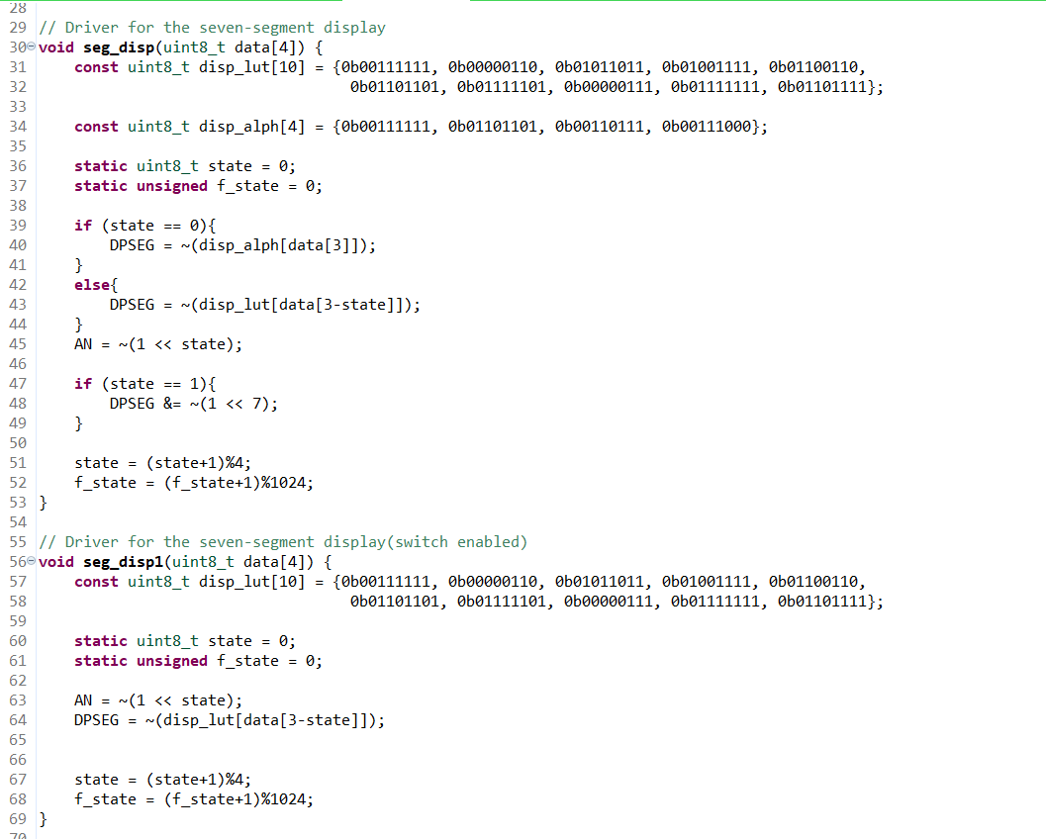
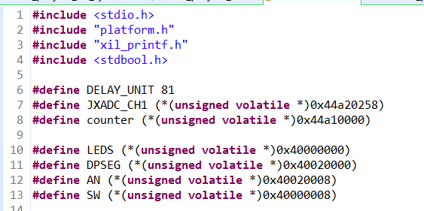
Software Integration
Macro Definitions in C
Segment Display Functions
06
07

Slide 8
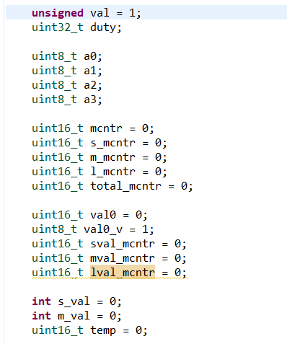
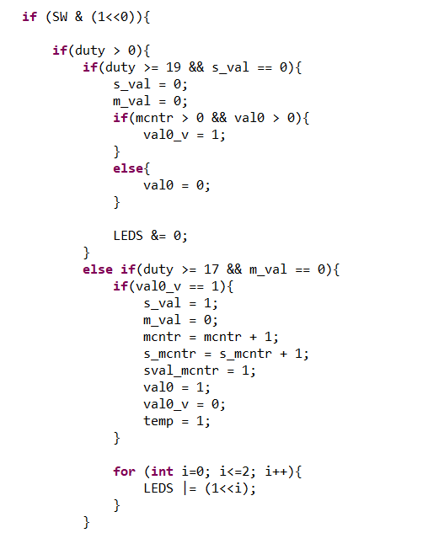
Software Integration
Main Program Variables
No Metal & Small Metal Detection
06
08

Slide 9
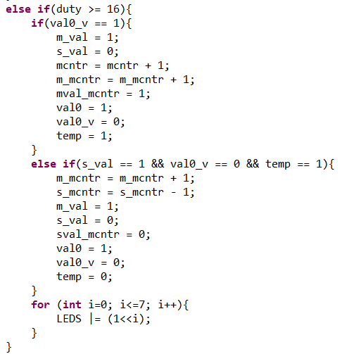
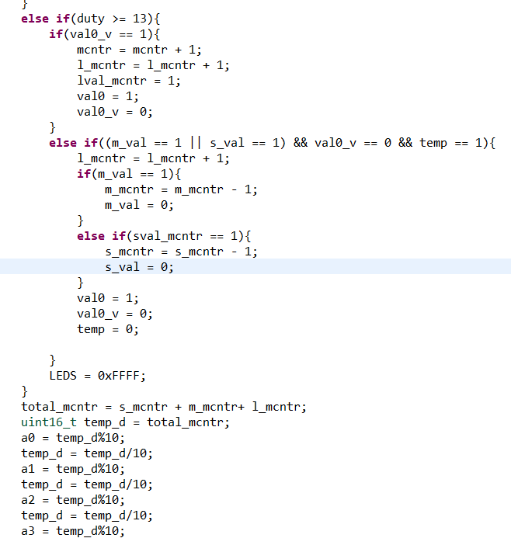
Software Integration
Medium Metal Detection
Large Metal Detection
09

Slide 10
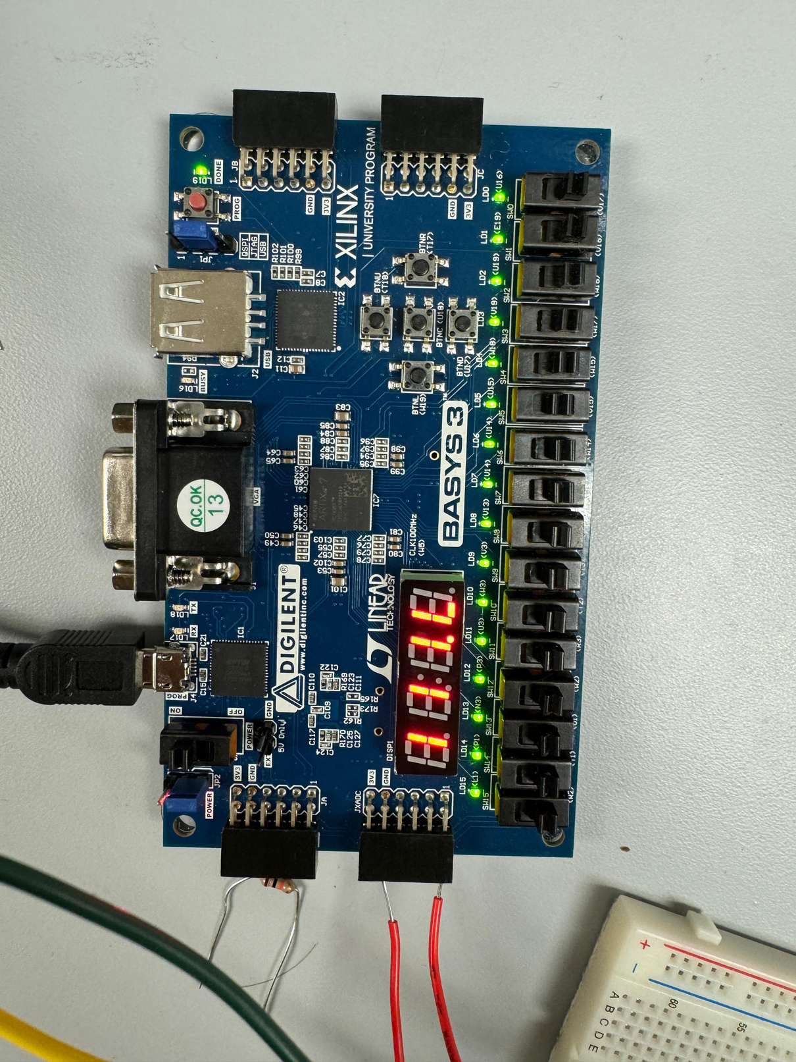
Results: Pros and Cons
The system designed successfully detects metal objects at close range
Records the number of times it was detected, and which metal object detected
Metal system glitches when detecting the largest metal object
Voltage degradation when the system is powered by a battery
Rapid increase of counter value
10
Fig. represents metal detection of a large metal object
Notes:
When a metal is detected, counter value increases rapidly with the delay function in while loop

Slide 11
Conclusion
EE and COE students jointly designed a metal detection system
Three key components used in the circuit design: Colpitts Oscillator, LM324 Op Amp Comparator, RC Low-Pass Filter
Software integration done by integrating analog input functionality into the FPGA design
The metal objects were detected upon testing.
Occasional glitches showed up while demonstrating
11
Notes:
A metal system was designed jointly by students of the electrical and computer engineering departments where the EE students designed the circuit and the COE students integrated it with the software

Slide 12
Thank You!
12

